Slide 1
Image Processing Case Study
Using Python, NumPy, Matplotlib, and PIL
Sivakandasamy velumani

Slide 2
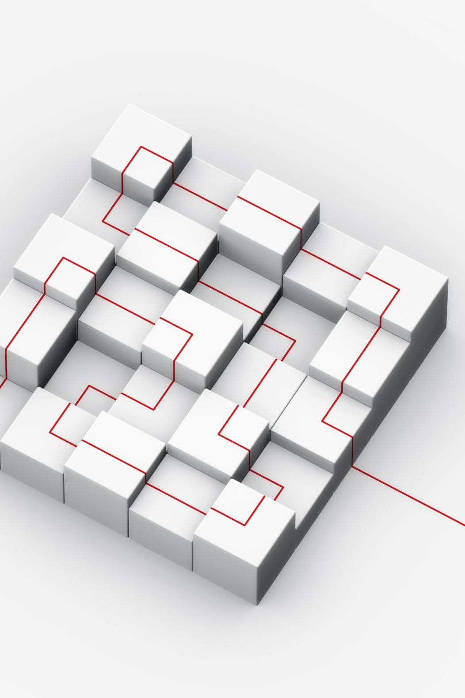
Introduction
This project focuses on basic image processing using Python libraries.
We manipulate images using NumPy arrays and visualize outputs using Matplotlib.

Slide 3

Objectives
- Load and display images
- Convert to grayscale
- Flip and rotate images
- Separate RGB channels
- Perform edge detection

Slide 4
Tools Used
- Python 3.11
- NumPy
- Matplotlib
- Pillow (PIL)

Slide 5
Methodology
1. Load the image using PIL
2. Convert to grayscale using NumPy
3. Flip and rotate using NumPy functions
4. Separate Red, Green, and Blue channels
5. Apply Sobel operator for edge detection

Slide 6

Results
- Grayscale Image
- Flipped Image
- Rotated Image
- RGB Channels
- Edge Detection Output

Slide 7
Conclusion
Image processing techniques like filtering and transformations are foundational in computer vision. This project demonstrates how NumPy can be used for low-level operations.

Slide 8
Demo Video
Watch the full demo:
https://drive.google.com/file/d/1F9wf9ir_QCQMiSS96Vlxhm3_IVhY9jo7/view?usp=drive_link

